Slide 1
“Time to Focus: Doing things better and differently for key populations” Partner notification HIV Self Testing and Social Network Testing
Dr Irene Mukui
National AIDs & STI Control Programme, Ministry of Health Kenya
AIDS 2018 Conference Amsterdam, 23rd July 2018

Slide 2
HIV Burden in Kenya, 2018
#KENYAatAIDS2018
HIV Prevalence = 4.9%
Female = 6.2% ; Male = 3.5%
PLHIV (all ages) = 1.5M
Adults living with HIV (15+)
= 1,388,200
Children living with HIV (0-14)
= 105,200
Number of new HIV Infections in 2017
Adolescent and Young People
Adolescents 10-19 years
All ages = 52,800
PLHIV = 105,200
New infections = 8,200
Adults (15+ = 44,800)
Young Adults 15-24 years
PLHIV = 184,700
New infections = 17,700
Children (0-14) = 8,000
Source : Kenya HIV estimates 2018

Slide 3
HIV Epidemic among Key Populations
Key populations contribute to 33% of all new infections
High HIV prevalence
High estimation of key populations
FSW
MSM
PWID
NASCOP Kenya. 2013. Kenya Most At Risk Populations Size Estimate
Consensus. Final Report. Nairobi: MoH
Notes:
FSW – 133,675 (76, 654 – 208,711)
MSM – 18,460 (9,660-32,886)
PWID – 18,327 (12,617 – 23,978)

Slide 4
The First 90 Testing Gap in Kenya
Gap
Est. PLHIV
Identified
Notes:
Bold the targeted

Slide 5
Strategic HIV Testing Approaches: HIV Self Testing
Kenya HIV self testing guidelines launched in 2017
Position HIVST as a strategy to achieve the 90 –90 –90 goals

Slide 6
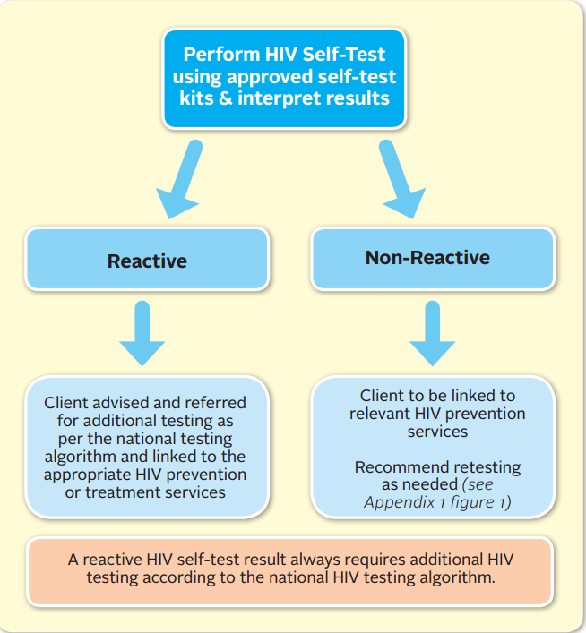
Prioritizing HIV Self Testing
Initial priority groups for HIVST
Partners of ANC/PNC clients
Men
Key Populations
Index Client Partners

Slide 7
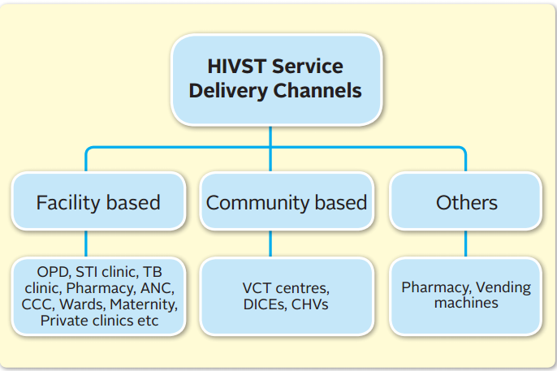
HIVST Delivery Channels & Strategy
Roll out is phased
Phase 1: 16/47 counties,
Phase 2: 15/47 counties
Phase 3: 156/47 counties
1
Current gap in the first 90
2
HIV incidence
3
Testing Yield (ANC, HTS, KP etc.)
4
Partner support
Time line: June 2018 – 2019
Notes:
Leave initial priority groups for HIVST; make not to extend to whoever needs it, include young people..

Slide 8
HIVST Delivery Channels & Strategy
Model | Population and Entry Point | Recommended Approach for Distribution
Facility | Partners of ANC/PNC/L&D clients | Distribute to clients for secondary distribution to their sexual partner, where partner status is unknown, and if risk of IPV has been assessed and is low.
 | Key Populations (MSM, FSW, PWIDs) | Distribution through DICES using peer educators
 | Partner of Index Client Partners found in: STI,TB, VCT/PITC, FP | Distribute to all clients testing positive for secondary distribution to their sexual partners, if risk of IPV has been assessed and is low
Community | Men | Distribution through outreaches e.g. door to door delivery, 70% of kits distributed should be to men
Pharmacy | General Population | Retail over the counter sales

Slide 9
Assisted Partner Notification Services
Cluster RCT conducted in Kenya
Progress
Ongoing integration feasibility study being conducted
National guidelines development ongoing to support implementation
Integration already ongoing
Comparison between immediate and delayed arms
Increase testing uptake among partner
Higher proportion of positives
Higher proportion linked to care
Higher proportion Tested for first time
aPNS did not increase intimate partner violence

Slide 10
Key lessons
Integrating innovative testing approaches such as self testing , aPNS is feasible
High acceptance and uptake
Proper planning , monitoring is needed
Integrated innovative monitoring strategies for community based approaches

Slide 11
Acknowledgments
MOH-NASCOP
Mary Mugambi
Helgar Musyoki
CDC kenya team
LVCT

